Slide 1

TV TIME
IHC – Assignment 1
2022/2023
Diogo Silva 104341
Rafael Amorim 98197
Tiago Alves 104110
Notes:
Line spacing + Page numbers

Slide 2
Schedule
01 Introduction
02 Heuristic Evaluation
03 Results and Solutions
04 Cognitive walkthrough
05 Appreciation

Slide 3
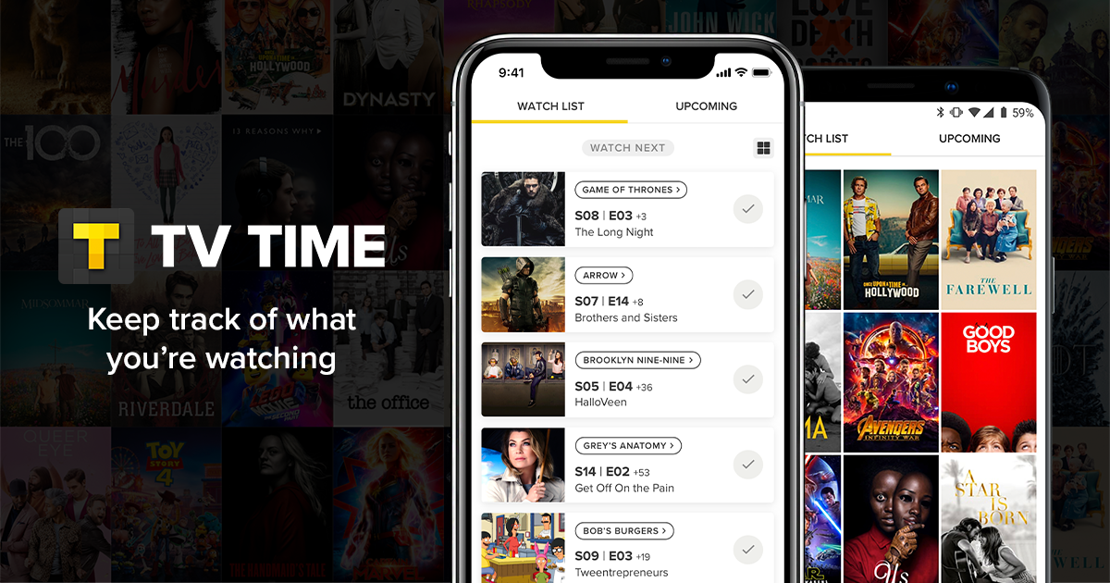
Introduction
01
What is TV Time?
What is the target audience?
Why did we choose this project?

Slide 4


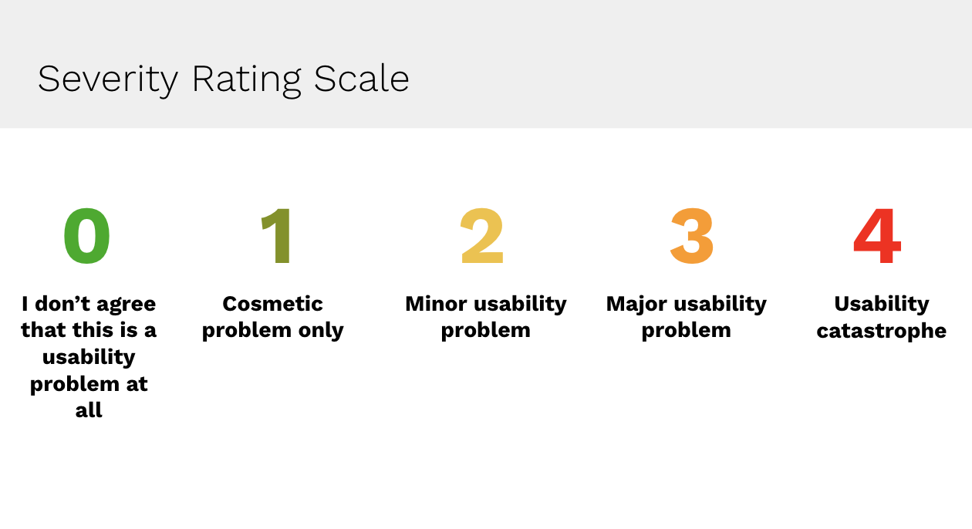

Heuristic Evaluation
02
To evaluate TV Time, we are using:
Jakob Nielsen’s 10 Heuristics for UI Design
Jakob Nielsen’s Severity Scale for Interaction Design

Slide 5
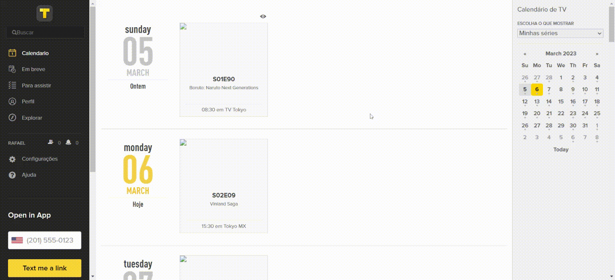
Heuristic Evaluation
02
Problem: Options hidden in the calendar
Heuristic: Match between system and the real world
Severity: 1
Description: While in the calendar it is possible to go back in the calendar while “scrolling up” to the top of the page. This option is hidden and less natural due to most of the apps using this action to refresh the page.

Slide 6
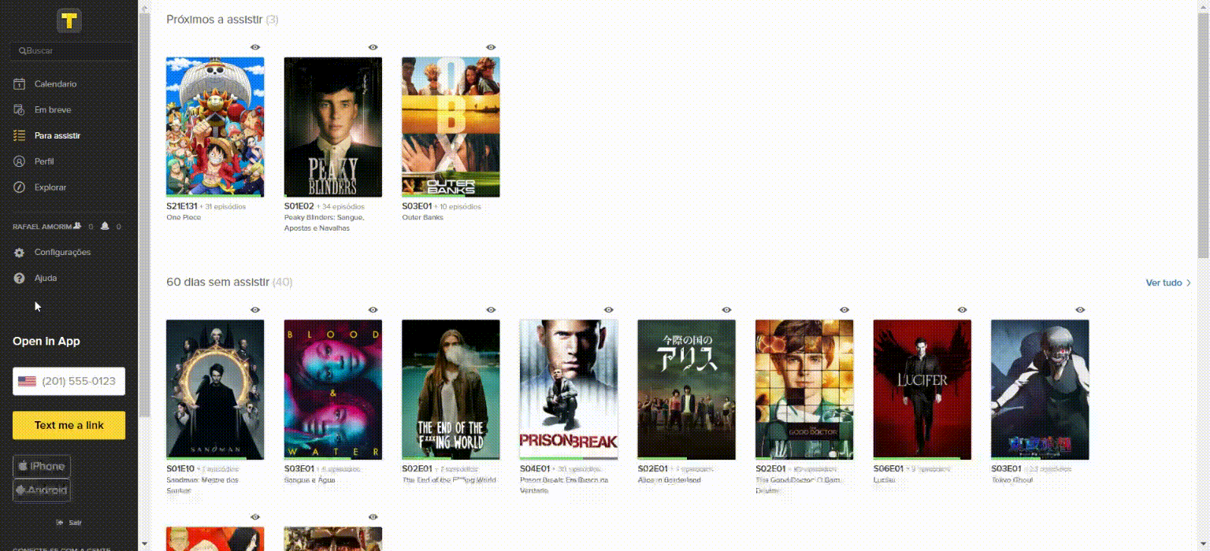
Heuristic Evaluation
02
Problem: Help button does not allow to go back
Heuristic: User control and freedom
Severity: 4
Description: In the case the user clicks in the button “help”, he is redirected to a new page without an option to go back without having to login again (the login does not even work).

Slide 7
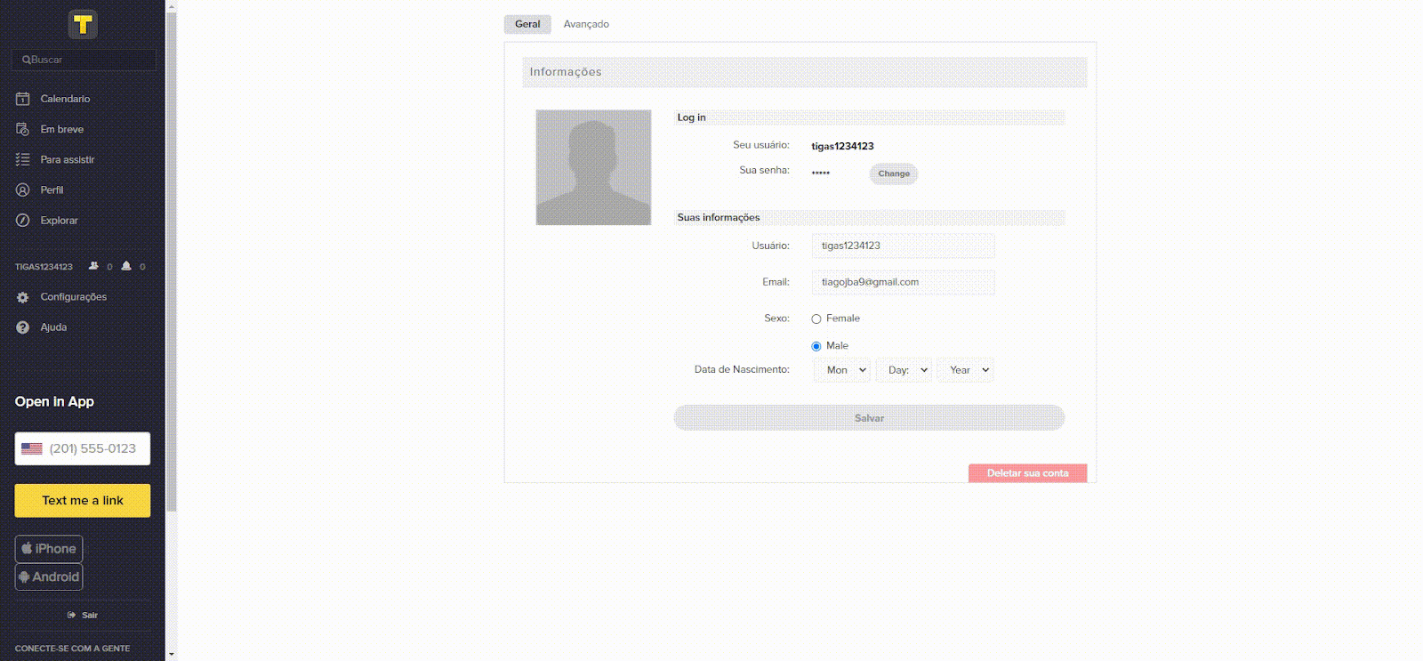
Heuristic Evaluation
02
Problem: Changing Password
Heuristic: Help users recognize, diagnose, and recover from errors
Severity: 4
Description: When changing passwords it is necessary to write the previous password. In case the password was wrong, the system will pretend the change was correct but it will not change to the new password

Slide 8
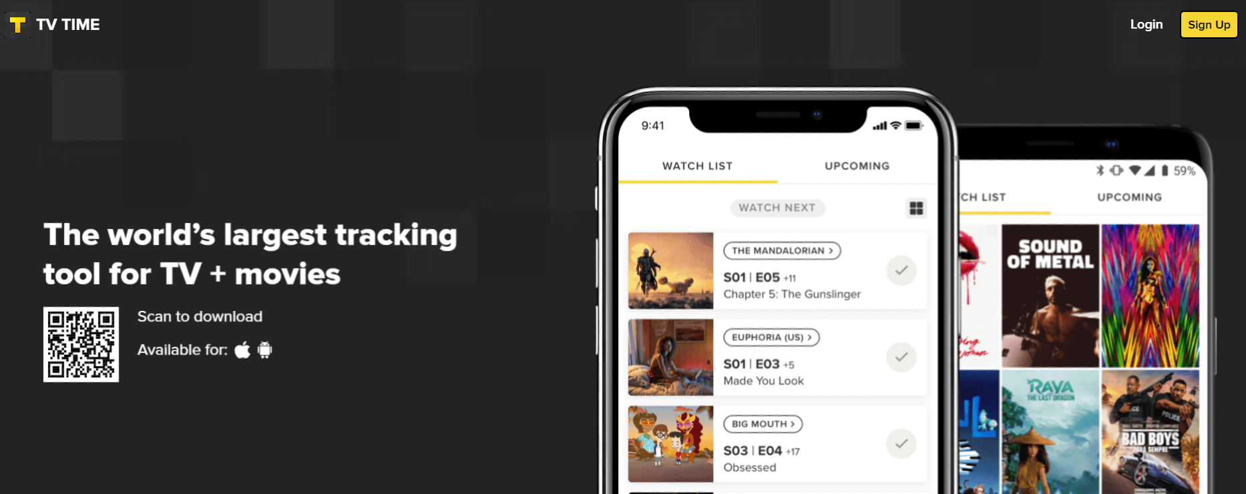
Heuristic Evaluation
02
Problem: Lack of documentation for the web page
Heuristic: Help and documentation
Severity: 3
Description: The help in the resolution of problems is strictly focused in the mobile app, therefore there is no useful documentation to solve problems for the web page users

Slide 9
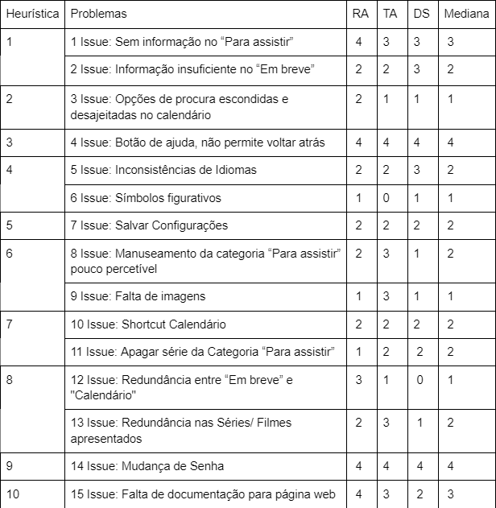
Results and Solutions
03

Slide 10

Cognitive Walkthrough
04
How to perfom cognitive walkthrough
We choose Streamlined CW method

Slide 11
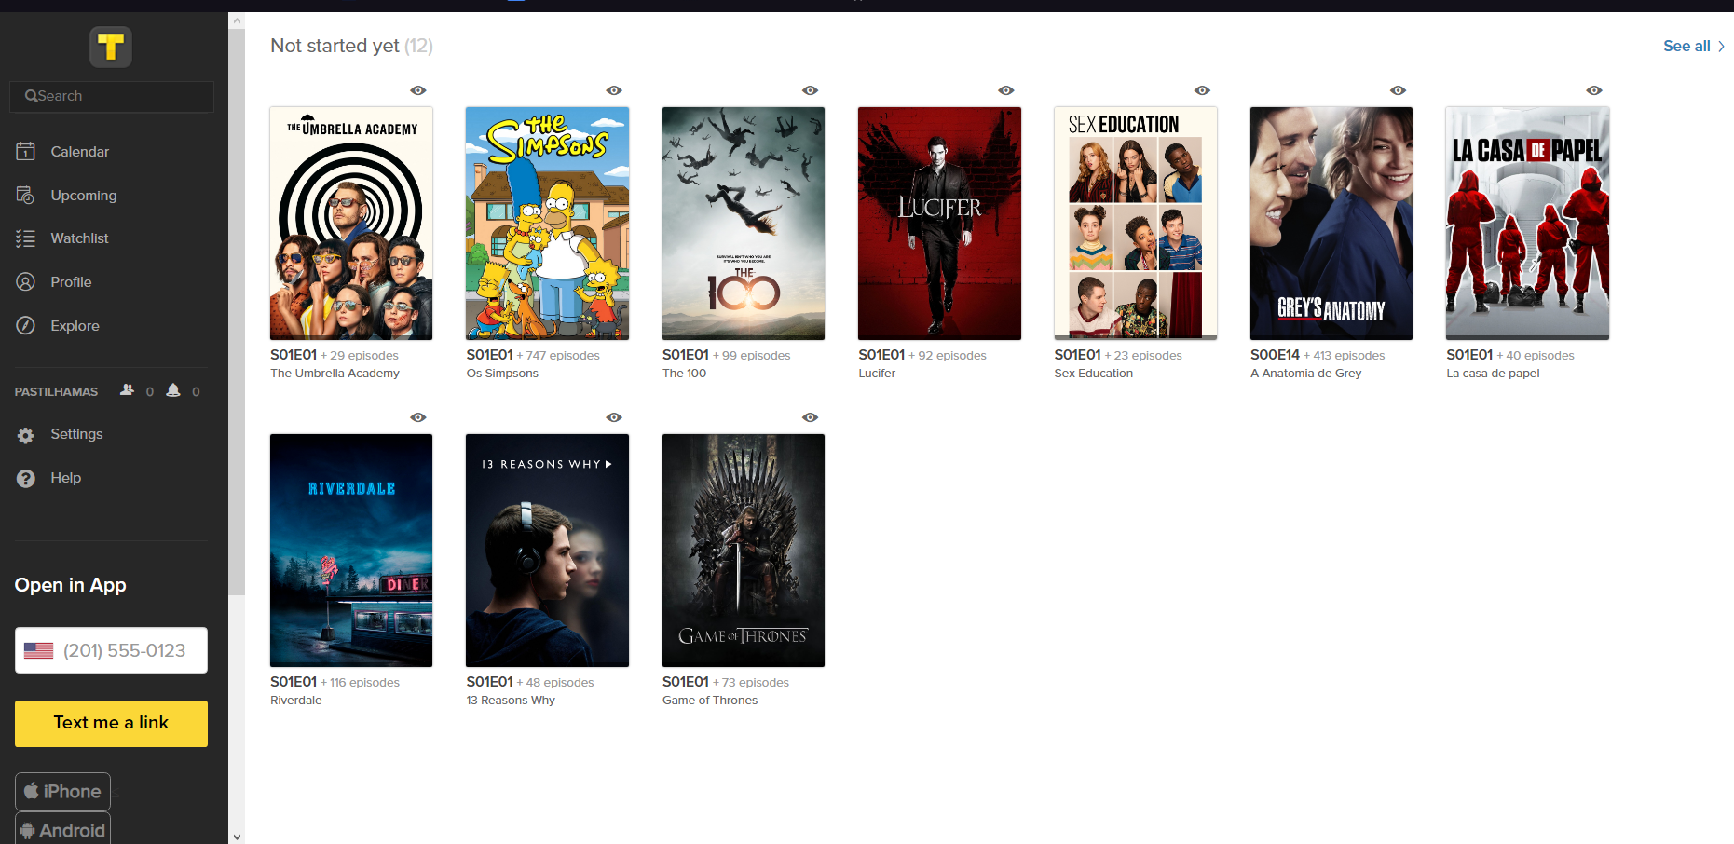
Cognitive Walkthrough
04
01. Objective 1
Add a movie to the watchlist
02. USER
A user of the platform that wants to place a
movie in the watchlist
03. QUESTION
Q1 - Will the user know what to do at this step?
Q2 - If the user does the right thing, will they know that they did the right thing, and are making progress towards their goal?

Slide 12
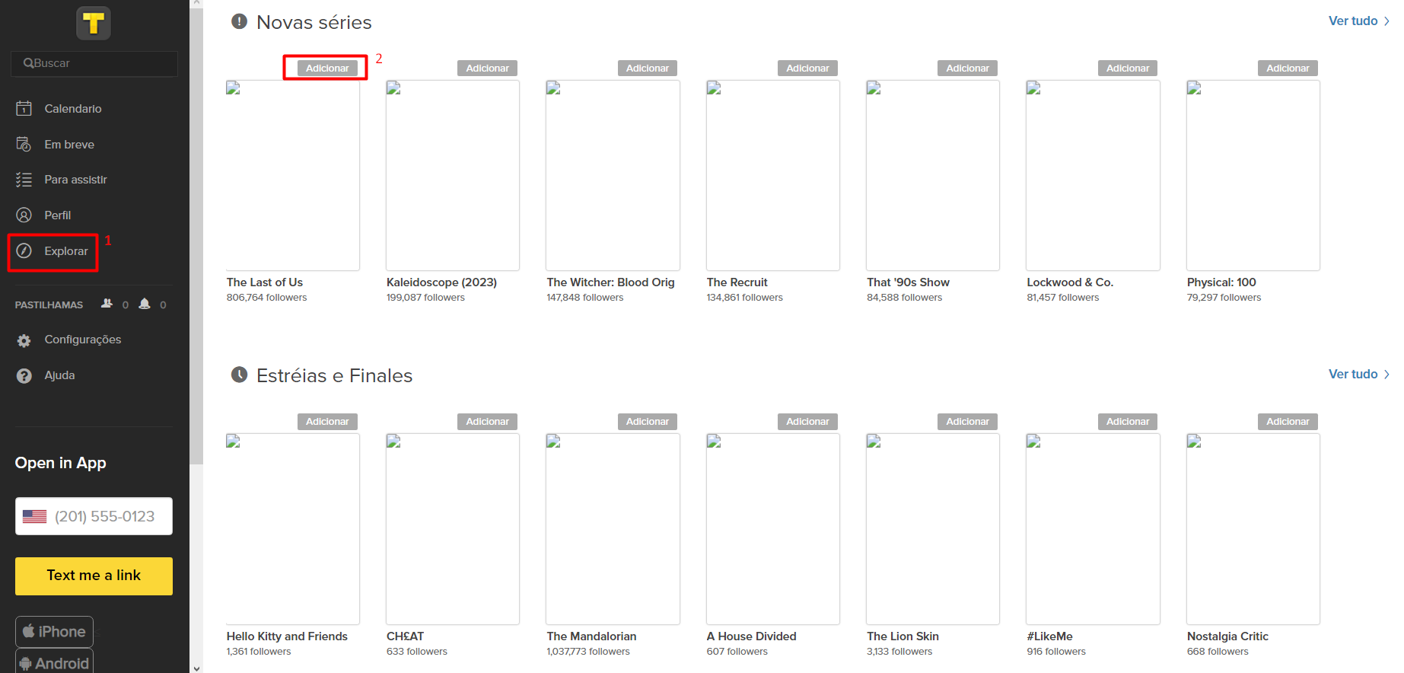
Cognitive Walkthrough
04
Action 1 - Search for a series to add
Q1 – Probably Yes
Issue : No indication of what to do in “To watch”
Q2 – Yes
Issue: Having no indication of what to do while in "To watch“
Action 2 – Find the add button
Q1 – Probably Yes
Q2 – Probably Yes (because the add button does not tell you where it is added)

Slide 13
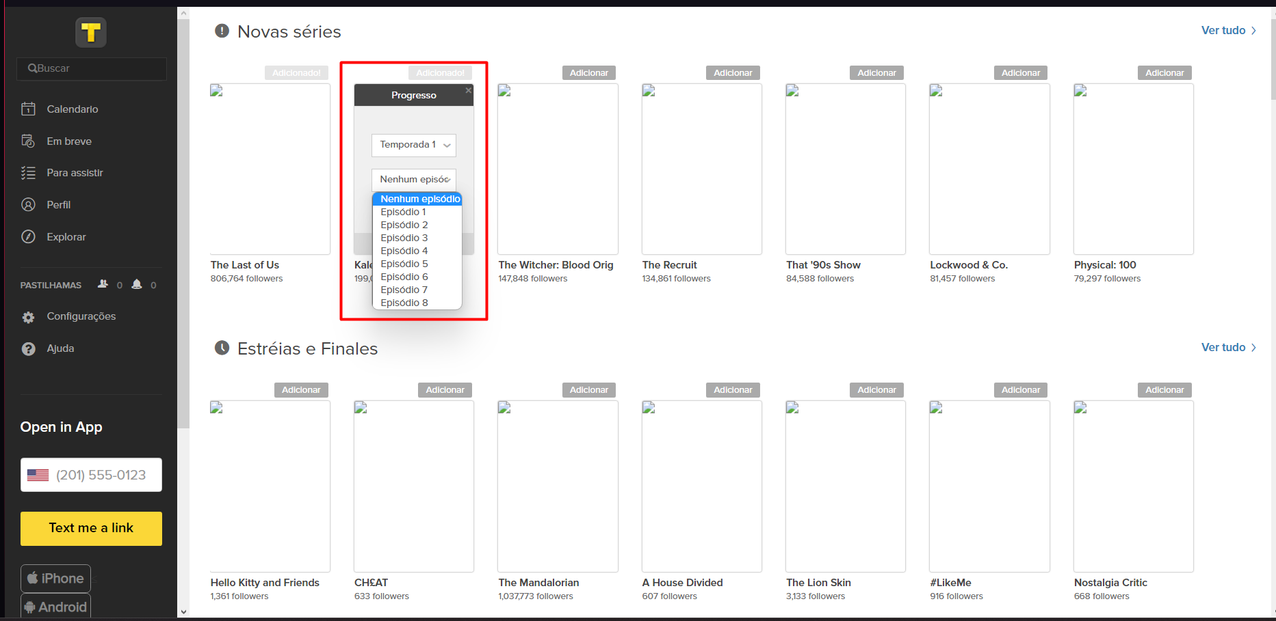
Cognitive Walkthrough
04
Action 3 – Add to the Watchlist defining the current episode
Q1 – Yes
Q2 – Yes
Action 4 – Remove the series
Q1 – Probably no
Q2 – Probably yes
Issue: You can't remove it from "To watch". You must search for the series/movie again and click on the title to remove it.
Solutions:

Slide 14
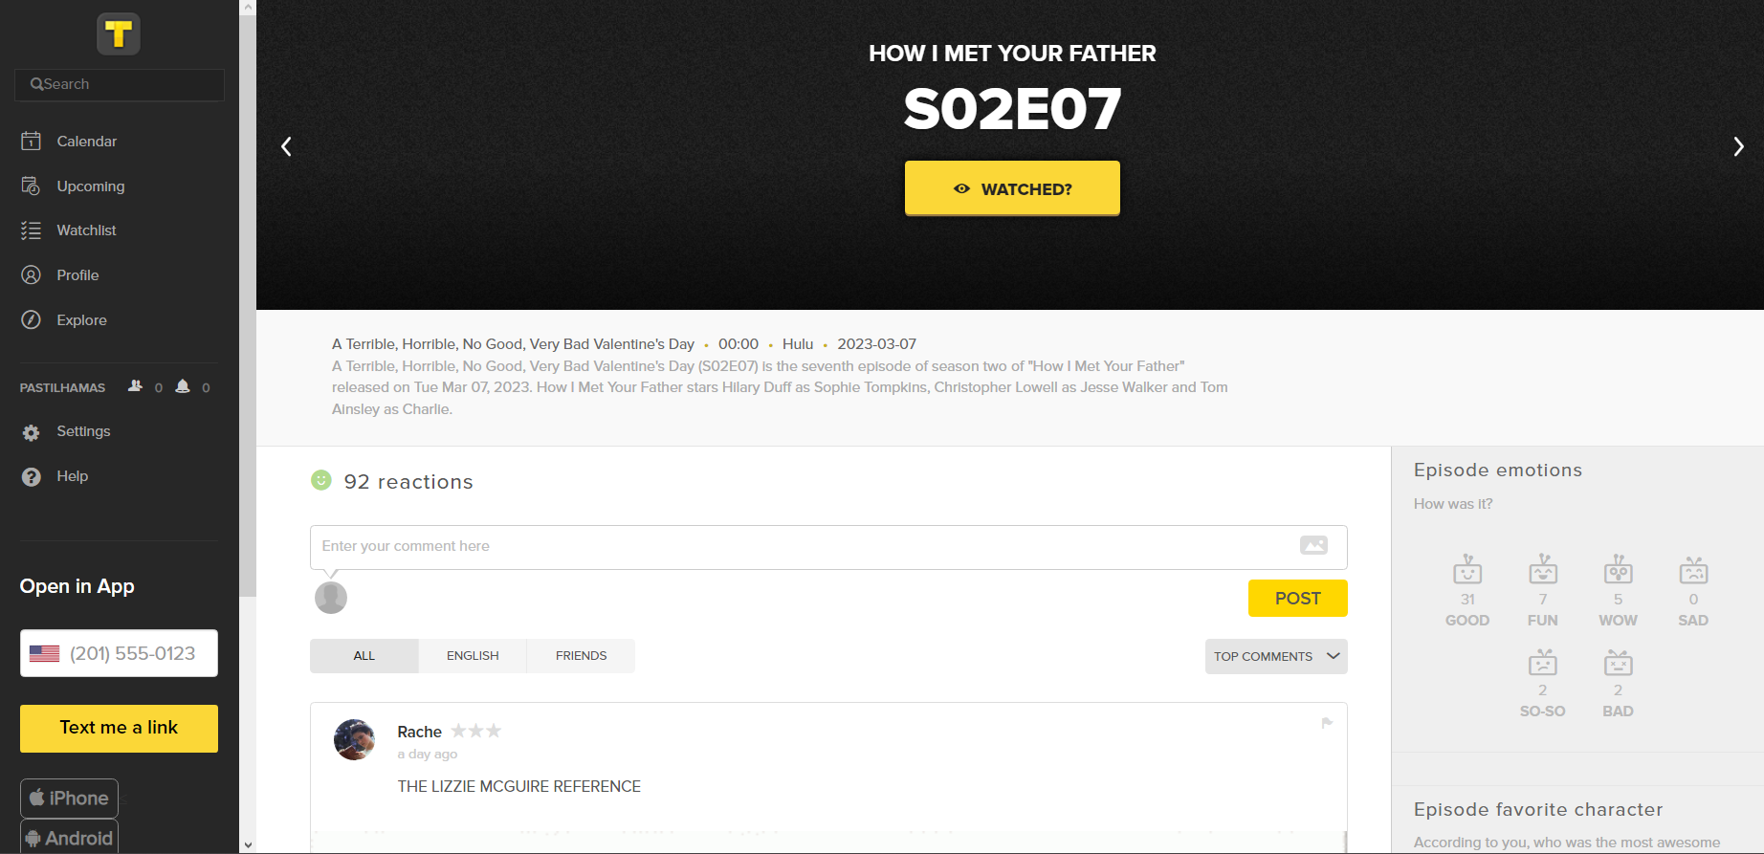
Cognitive Walkthrough
04
01. Objective 2
Find Comments about a film/series trough the Comedy genre
02. USER
A user of the platform that wants to find a
film/series to watch
03. QUESTION
Q1 - Will the user know what to do at this step?
Q2 - If the user does the right thing, will they know that they did the right thing, and are making progress towards their goal?

Slide 15
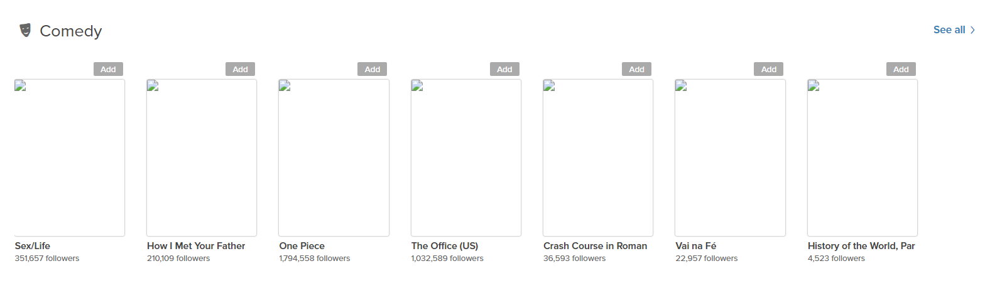
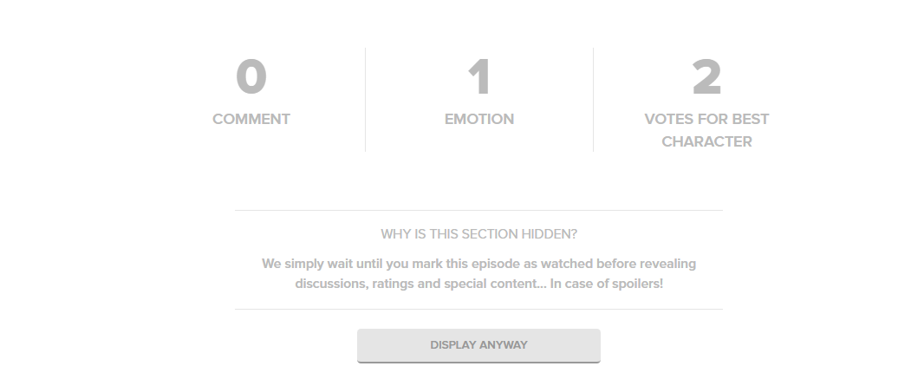
Cognitive Walkthrough
04
Action 1 – Search by genre’s
Q1 – Maybe
Issue: It is not possible to use the search bar for the genre and there are no indications where you could do such a thing.
Q2 – Yes
Action 2 – Find a Comedy Film
Q1 – Yes
Q2 – Yes
Action 3 – Find Information in the comments
Positive note: You can hide spoilers
Q1 – Probably Yes
Q2 - Yes

Slide 16
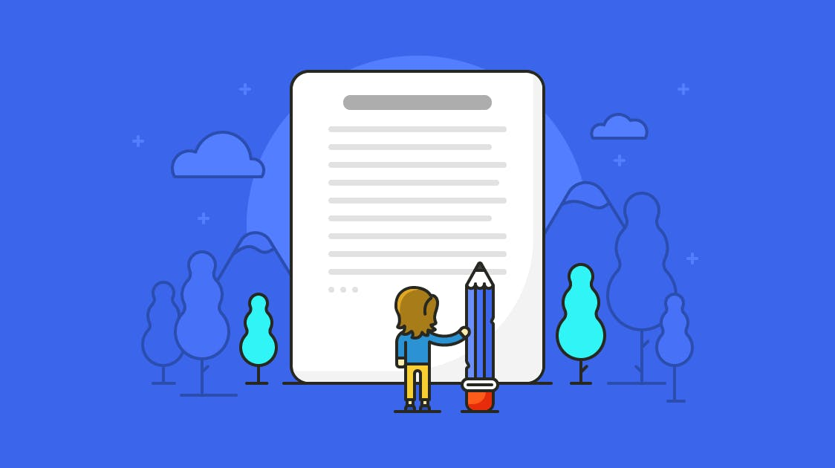
Appreciation
05
In general, it is useful for the users
Great tool to organize your to-watch list
However
Insufficient support
Various security and information problems
Unnecessary information

